Slide 1
Baze podataka
Prof. Dr. Mirjana Misita

Slide 2
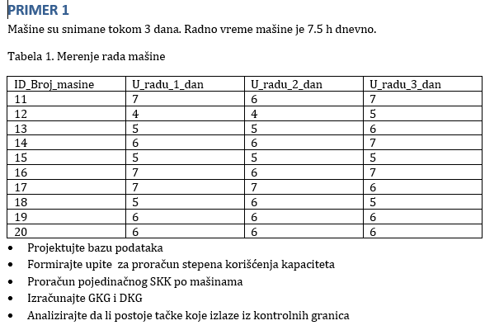
Proračun SKK po mašinama

Slide 3
Najpre transponujemo tabelu
Kreiramo novu tabelu SKKmasina
DROP TABLE IF EXISTS SKKmasina;
CREATE TABLE SKKmasina (
dan VARCHAR(10) PRIMARY KEY,
`11` INT NOT NULL,
`12` INT NOT NULL,
`13` INT NOT NULL,
`14` INT NOT NULL,
`15` INT NOT NULL,
`16` INT NOT NULL,
`17` INT NOT NULL,
`18` INT NOT NULL,
`19` INT NOT NULL,
`20` INT NOT NULL
);
Dan | 11 | 12 | 13 | 14 | 15 | 16 | 17 | 18 | 19 | 20
1dan | 7 | 4 | 5 | 6 | 5 | 7 | 7 | 5 | 6 | 6
2dan | 6 | 4 | 5 | 6 | 5 | 6 | 7 | 6 | 6 | 6
3dan | 7 | 5 | 6 | 7 | 5 | 7 | 6 | 5 | 6 | 6

Slide 4
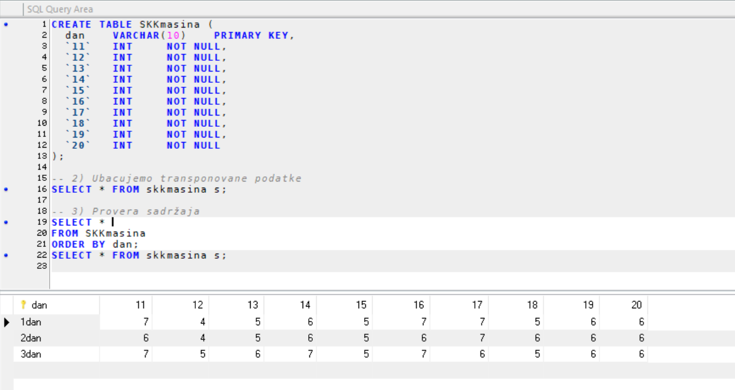
Ubacujemo transponovane podatke
INSERT INTO SKKmasina (dan, `11`,`12`,`13`,`14`,`15`,`16`,`17`,`18`,`19`,`20`) VALUES
('1dan', 7, 4, 5, 6, 5, 7, 7, 5, 6, 6),
('2dan', 6, 4, 5, 6, 5, 6, 7, 6, 6, 6),
('3dan', 7, 5, 6, 7, 5, 7, 6, 5, 6, 6);
Provera sadržaja
SELECT *
FROM SKKmasina
ORDER BY dan;

Slide 5
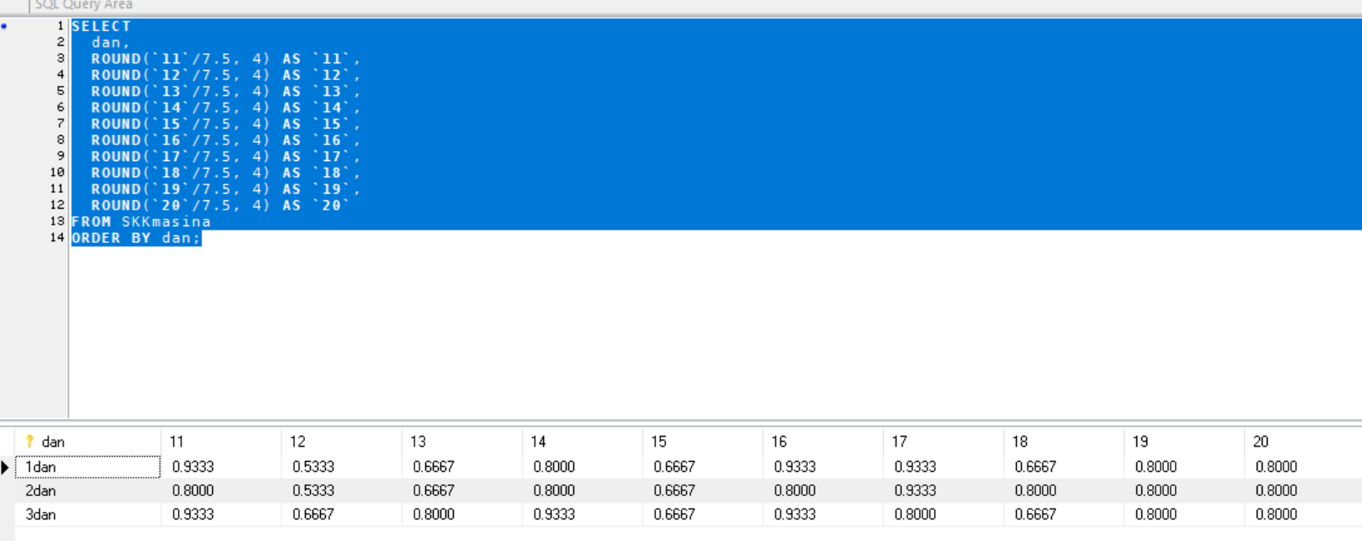
Delimo svaku vrednost rada sa 7.5 da dobijemo SKK:
SELECT
dan,
ROUND(`11`/7.5, 4) AS `11`,
ROUND(`12`/7.5, 4) AS `12`,
ROUND(`13`/7.5, 4) AS `13`,
ROUND(`14`/7.5, 4) AS `14`,
ROUND(`15`/7.5, 4) AS `15`,
ROUND(`16`/7.5, 4) AS `16`,
ROUND(`17`/7.5, 4) AS `17`,
ROUND(`18`/7.5, 4) AS `18`,
ROUND(`19`/7.5, 4) AS `19`,
ROUND(`20`/7.5, 4) AS `20`
FROM SKKmasina
ORDER BY dan;

Slide 6
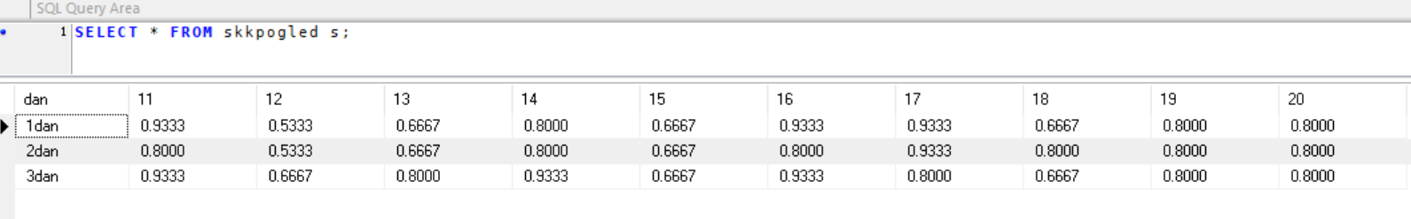
Ovaj rezultat mozemo da sacuvamo kao novi pogled.
CREATE VIEW `zzzz`.`SKKpogled` AS
SELECT
dan,
ROUND(`11`/7.5, 4) AS `11`,
ROUND(`12`/7.5, 4) AS `12`,
ROUND(`13`/7.5, 4) AS `13`,
ROUND(`14`/7.5, 4) AS `14`,
ROUND(`15`/7.5, 4) AS `15`,
ROUND(`16`/7.5, 4) AS `16`,
ROUND(`17`/7.5, 4) AS `17`,
ROUND(`18`/7.5, 4) AS `18`,
ROUND(`19`/7.5, 4) AS `19`,
ROUND(`20`/7.5, 4) AS `20`
FROM SKKmasina
ORDER BY dan;

Slide 7
Zaokruživanje („ROUND“) se uvodi iz dva ključna razloga:
Povećanje preglednosti
Rezultati deljenja često vode ka beskonačnim ili veoma dugim decimalnim zapisima (npr. 0.6666666667…). Zaokruživanjem na unapred definisani broj decimala (najčešće 2–4) dobija se čitljivija tabela u kojoj je lako upoređivati vrednosti i brzo detektovati eventualne odstupanja.
Standardizacija proračuna
Kada se ti zaokruženi rezultati kasnije koriste u daljim analizama—računanju proseka, kontrolnih granica ili izradi izveštaja—osigurava se dosledna preciznost i izbegavaju sitne razlike koje proizlaze iz plivajuće tačke. U zavisnosti od potreba projekta, broj decimala može biti podešen na dve, tri ili više, a u slučajevima gde je maksimalna tačnost presudna, može se zaobići i zaokruživanje.

Slide 8
Za prvu masinu 11, gornja granica racunala bi se:
SELECT
AVG(`11`)
+ 3 * STDDEV(`11`)
AS GKG
FROM skkpogled s;

Slide 9
Za sve masine:
SELECT
ROUND(AVG(`11`)+3*STDDEV(`11`),4) AS GKG_11,
ROUND(AVG(`12`)+3*STDDEV(`12`),4) AS GKG_12,
ROUND(AVG(`13`)+3*STDDEV(`13`),4) AS GKG_13,
ROUND(AVG(`14`)+3*STDDEV(`14`),4) AS GKG_14,
ROUND(AVG(`15`)+3*STDDEV(`15`),4) AS GKG_15,
ROUND(AVG(`16`)+3*STDDEV(`16`),4) AS GKG_16,
ROUND(AVG(`17`)+3*STDDEV(`17`),4) AS GKG_17,
ROUND(AVG(`18`)+3*STDDEV(`18`),4) AS GKG_18,
ROUND(AVG(`19`)+3*STDDEV(`19`),4) AS GKG_19,
ROUND(AVG(`20`)+3*STDDEV(`20`),4) AS GKG_20
FROM SKKpogled s;

Slide 10
SELECT
ROUND(GREATEST(AVG(`11`)-3*STDDEV(`11`),0),4) AS DKG_11,
ROUND(GREATEST(AVG(`12`)-3*STDDEV(`12`),0),4) AS DKG_12,
ROUND(GREATEST(AVG(`13`)-3*STDDEV(`13`),0),4) AS DKG_13,
ROUND(GREATEST(AVG(`14`)-3*STDDEV(`14`),0),4) AS DKG_14,
ROUND(GREATEST(AVG(`15`)-3*STDDEV(`15`),0),4) AS DKG_15,
ROUND(GREATEST(AVG(`16`)-3*STDDEV(`16`),0),4) AS DKG_16,
ROUND(GREATEST(AVG(`17`)-3*STDDEV(`17`),0),4) AS DKG_17,
ROUND(GREATEST(AVG(`18`)-3*STDDEV(`18`),0),4) AS DKG_18,
ROUND(GREATEST(AVG(`19`)-3*STDDEV(`19`),0),4) AS DKG_19,
ROUND(GREATEST(AVG(`20`)-3*STDDEV(`20`),0),4) AS DKG_20
FROM SKKpogled s;

Slide 11
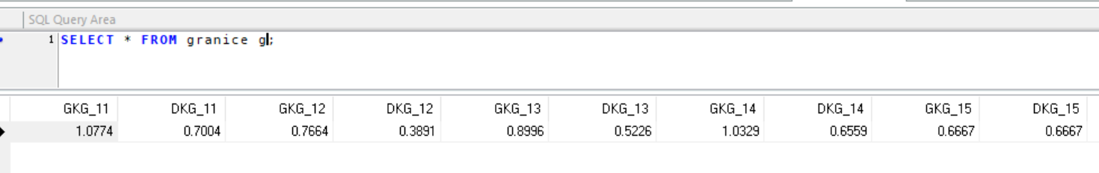
Zajedno sve:
SELECT
-- Mašina 11
ROUND(AVG(`11`) + 3*STDDEV(`11`),4) AS GKG_11,
ROUND(GREATEST(AVG(`11`) - 3*STDDEV(`11`),0),4) AS DKG_11,
-- Mašina 12
ROUND(AVG(`12`) + 3*STDDEV(`12`),4) AS GKG_12,
ROUND(GREATEST(AVG(`12`) - 3*STDDEV(`12`),0),4) AS DKG_12,
-- Mašina 13
ROUND(AVG(`13`) + 3*STDDEV(`13`),4) AS GKG_13,
ROUND(GREATEST(AVG(`13`) - 3*STDDEV(`13`),0),4) AS DKG_13,
-- Mašina 14
ROUND(AVG(`14`) + 3*STDDEV(`14`),4) AS GKG_14,
ROUND(GREATEST(AVG(`14`) - 3*STDDEV(`14`),0),4) AS DKG_14,
-- Mašina 15
ROUND(AVG(`15`) + 3*STDDEV(`15`),4) AS GKG_15,
ROUND(GREATEST(AVG(`15`) - 3*STDDEV(`15`),0),4) AS DKG_15,
-- Mašina 16
ROUND(AVG(`16`) + 3*STDDEV(`16`),4) AS GKG_16,
ROUND(GREATEST(AVG(`16`) - 3*STDDEV(`16`),0),4) AS DKG_16,
-- Mašina 17
ROUND(AVG(`17`) + 3*STDDEV(`17`),4) AS GKG_17,
ROUND(GREATEST(AVG(`17`) - 3*STDDEV(`17`),0),4) AS DKG_17,
-- Mašina 18
ROUND(AVG(`18`) + 3*STDDEV(`18`),4) AS GKG_18,
ROUND(GREATEST(AVG(`18`) - 3*STDDEV(`18`),0),4) AS DKG_18,
-- Mašina 19
ROUND(AVG(`19`) + 3*STDDEV(`19`),4) AS GKG_19,
ROUND(GREATEST(AVG(`19`) - 3*STDDEV(`19`),0),4) AS DKG_19,
-- Mašina 20
ROUND(AVG(`20`) + 3*STDDEV(`20`),4) AS GKG_20,
ROUND(GREATEST(AVG(`20`) - 3*STDDEV(`20`),0),4) AS DKG_20
FROM SKKpogled s;
i sve to snimimo kao novi pogled kontrolne granice - ‘’granice’’

